Slide 1
9 items
$$3$$
Anna
Q
Pink
Book
Similar
F
Pea
Dog

Slide 2
9 items (answer)
$$3$$
Anna
Q
Pink
Book
Similar
F
Pea
Dog

Slide 3
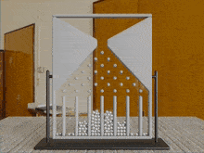
9 items (with a twist)
$$8$$
Tom
V
Blue
Table
Quiet
H
Bee
Cow

Slide 4
9 items (with a twist)
$$8$$
Tom
V
Blue
Table
Quiet
H
Bee
Cow

